Slide 1

NAME : OM RAMESHBHAI GAJJAR
COURSE NAME : MERN STTACK DEVELOPER
JOINING DATE : 12/09/2024
CLASS TIMINGS : 08:00 TO 10:00 AM
CLASS DAY : TUESDAY, THURSDAY, SATURDAY

Slide 2
INDEX
SOFTWARE ENGINEERING ASSIGNMENT
Sr. No. | Title | Slide No.
1. | What Is Software? What Is Software Engineering? | 3-4
2. | Explain Types Of Software | 5
3. | What Is SDLC? Explain Each Phase Of SDLC | 6
4. | What Is DFD? Create A DFD Diagram On Flipkart | 7-8
5. | What Is Flow Chart? Create A Flowchart To Make Addition Of Two Numbers | 9-10
6. | What Is Use Case Diagram? Create A Use-case On Bill Payment On Paytm | 11-12

Slide 3
1(1). WHAT IS SOFTWARE?
What Is Software?
Definition: Software Is A Set Of Instructions That Tells A Computer What To Do.
Types: It Comes In Two Main Types: System Software (Like Operating Systems) And Application Software (Like Games Or Word Processors).
Purpose: Software Helps Users Perform Tasks On Computers, From Browsing The Internet To Creating Documents.

Slide 4
1(2). WHAT IS SOFTWARE ENGINEERING?
What is Software Engineering?
Definition: Software engineering is the process of designing and building software.
Steps: It includes understanding what users need, planning the software, writing the code, testing it, and fixing any issues.
Goal: The aim is to create software that works well, is easy to use, and meets the needs of users.

Slide 5
2. EXPLAIN TYPES OF SOFTWARE
Types of Software
System Software: This is the foundational software that runs the computer. Examples include:
Windows: A popular operating system for personal computers.
macOS: The operating system for Apple computers.
Linux: An open-source operating system used on various devices.
Application Software: These programs are designed for specific tasks. Examples include:
Microsoft Word: A word processor for creating documents.
Google Chrome: A web browser for surfing the internet.
Adobe Photoshop: Software for photo editing and graphic design.
Utility Software: This helps manage and maintain your computer. Examples include:
Norton Antivirus: Protects against malware and viruses.
CCleaner: Cleans up unnecessary files to free up space.
WinRAR: Compresses files and manages archives.
Development Software: These tools assist programmers in creating software. Examples include:
Visual Studio: An IDE for developing applications on Windows.
Eclipse: An open-source IDE mainly for Java development.
GitHub: A platform for version control and collaboration on coding projects.

Slide 6
3.WHAT IS SDLC? EXPLAIN EACH PHASE OF SDLC
What is SDLC?
SDLC stands for Software Development Life Cycle. It’s a process that guides the development of software from start to finish.
Phases of SDLC
Planning: This is where the project starts. The team discusses what the software needs to do and sets goals and a budget.
Requirements Analysis: In this phase, the team talks to users to find out what they want. They gather all the necessary details about the software features.
Design: Here, the team outlines how the software will look and work. They create sketches or models to show the layout and functions.
Implementation: This is when the actual coding happens. Developers write the code based on the design to build the software.
Testing: After coding, the software is tested to find and fix any bugs or issues. This ensures it works as intended before it’s released.
Deployment: Once testing is complete, the software is released to users. This phase involves installing it and making it available.
Maintenance: After deployment, the software needs ongoing support. This phase includes fixing any problems that arise and updating the software with new features as needed.

Slide 7
4(1). WHAT IS DFD?
What is DFD?
A DFD, or Data Flow Diagram, is a visual tool that shows how information moves within a system. It helps to map out how data is processed and flows from one part of the system to another.
In a DFD, you can see different components like:
Processes: These are the activities that change or handle data.
Data Stores: These are places where data is stored, like databases.
External Entities: These are outside users or systems that interact with the software.
DFDs are useful for understanding and improving how a system works by clearly showing how data travels and where it goes.

Slide 8
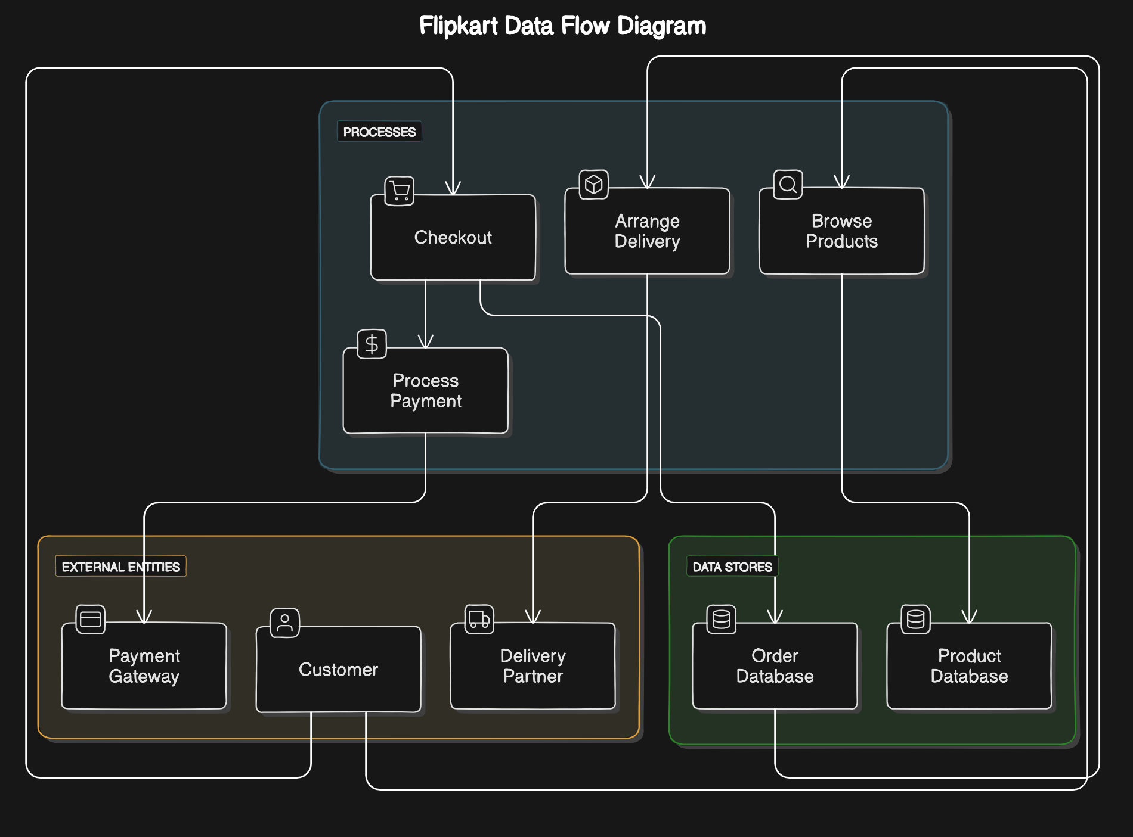
4(2). CREATE A DFD DIAGRAM ON FLIPKART

Slide 9
5(1). WHAT IS FLOW CHART?
What Is A Flow Chart?
A Flow Chart Is A Visual Representation That Outlines The Steps In A Process Or System. It Uses Different Shapes To Illustrate Various Actions, Decisions, And Flows Of Information.
Shapes:
Ovals Mark The Starting And Ending Points Of The Process.
Rectangles Indicate Actions Or Tasks That Need To Be Performed, Like "Collect Data" Or "Process Order."
Diamonds Represent Decision Points Where A Choice Must Be Made, Such As "Is The Order Complete?" This Leads To Different Paths Based On The Answer.
Arrows Connect These Shapes To Show The Direction Of Flow, Guiding Viewers Through The Steps.
Flow Charts Are Useful In Many Areas, Such As Business, Education, And Programming, As They Help To Understand How Processes Are Work, Identify Potential Problems, And Improve Efficiency By Making Everything Easy To Understand.

Slide 10
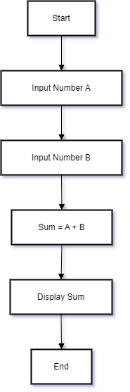
5(2). CREATE A FLOWCHART TO MAKE ADDITION OF TWO NUMBERS

Slide 11
6(1). WHAT IS USE CASE DIAGRAM?
A use case diagram is a simple way to show how people (called actors) interact with a system. Think of it like a map that shows what different users can do with a system, like an app or a website.
Key Points:
Actors: These are the users or other systems that use the main system. For example, a "Customer" or an "Admin."
Use Cases: These are the actions or tasks that the actors can perform. For example, "Place Order" or "Update Profile."
System Boundary: This is just a box that shows what’s inside the system and what’s outside.
Purpose:
Use case diagrams help everyone understand what the system can do and how users will interact with it. They're useful for planning and making sure the right features are included.
Example:
Imagine an online shopping site. A use case diagram would show actions like "Browse Products," "Add to Cart," and "Checkout," with lines connecting these actions to the actors like "Customer."

Slide 12
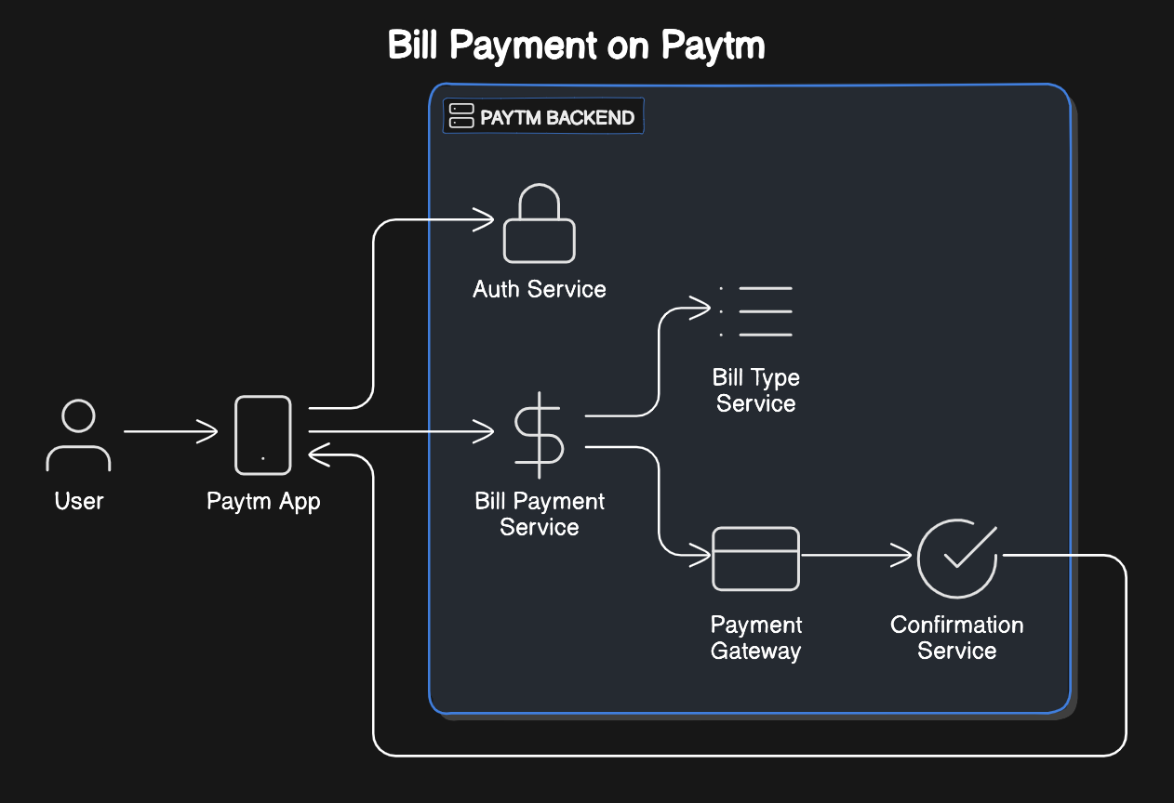
6(2). CREATE A USE-CASE ON BILL PAYMENT ON PAYTM.

